Slide 1
Version Control Systems
Git
Roxana Sipos-Lascu
Endava
Alexandru Pirvu
FXBITS

Slide 2
Agenda
Version Control Systems
What is a VCS?
Life before VCSs
Benefits of using a VCS
Types of VCSs
Git
What is Git?
Basic concepts
Bitbucket
What is Bitbucket?
Working with Git on a local repository
Working with Git on a remote repository
Creating a remote repository
Cloning an existing remote repository

Slide 3
Version Control Systems

Slide 4
1.1. What is a VCS?
Version control systems (VCS), also known as Source Control Management (SCM), are tools responsible for managing changes to source code or other files over time. Version control software keeps track of every modification to the code, so it allows you to revert selected files or the entire project back to a previous state, compare changes over time, see who modified something (that might be causing a problem) and when etc.

Slide 5
1.2. Life before VCSs
Multiple developers working on a shared codebase often need to make edits to the same piece of code.
Before the adoption of VCS this was a nightmare scenario. Developers would edit text files directly and move them around to remote locations using FTP or other protocols. Developer 1 would make edits and Developer 2 would unknowingly save over Developer 1’s work and wipe out the changes.
VCS brought safeguards to prevent loss of work due to conflict overwriting. These safeguards work by tracking changes from each individual developer, identifying areas of conflict and preventing overwrites. The developers can safely review the points of conflict and solve them.

Slide 6
1.3. Benefits of using a VCS
A complete change history of every file. In case of issues, having the complete history enables reverting back to previous versions. It is also possible to undo specific edits that too without losing the work done in the meanwhile.
Branching and merging. Team members can work concurrently on independent streams of changes, and it is up to them when they wish to share their changes with the rest of the team. With VCS, developers can work independently on separate branches of feature development, eventually merging them together.
Traceability. Being able to annotate each change with a message describing the purpose and intent of the change plays an important role for root cause analysis and maintenance. It can be easily known when, why, and by whom any part of a file was edited.

Slide 7
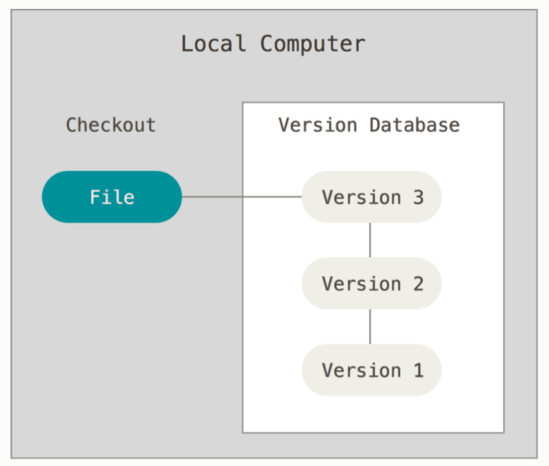
1.4. Types of VCSs (1)
Local Version Control Systems
It is one of the simplest forms and has a database that kept all the file changes under revision control. RCS is one of the most popular VCS tools. It keeps patch sets (differences between files) in a special format on disk. By adding up all the patches it can then re-create what any file looked like at any point in time.

Slide 8
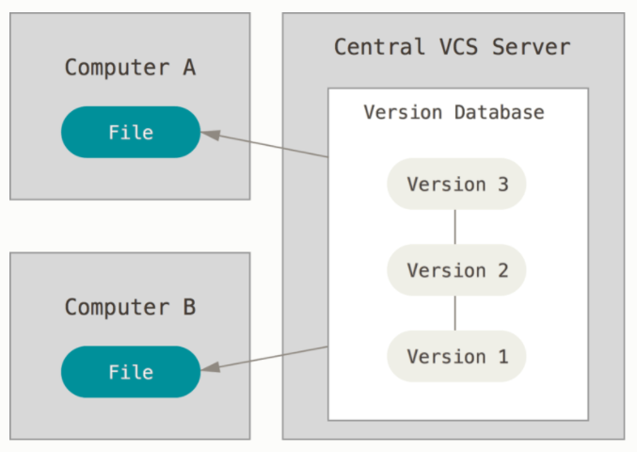
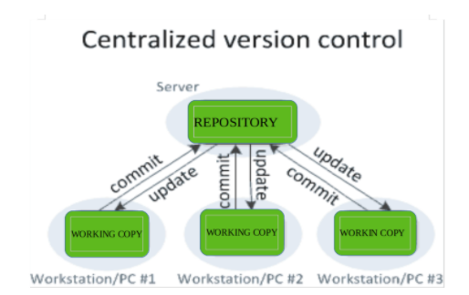
1.4. Types of VCSs (2)
Centralized Version Control Systems
CVC systems enable collaboration amongst developers. They contain just one repository and each user gets their own working copy. You need to commit to reflecting your changes in the repository. It is possible for others to see your changes by updating.
The most obvious downside of CVC systems is the single point of failure that the centralized repository represents. If it goes down, during that period collaboration and saving versioned changes is not possible. If the hard disk the central database is on becomes corrupted, and proper backups haven’t been kept, the entire history of the project is lost (except whatever single snapshots people happen to have on their local machines). Local VC systems suffer from this same problem — whenever you have the entire history of the project in a single place, you risk losing everything.

Slide 9
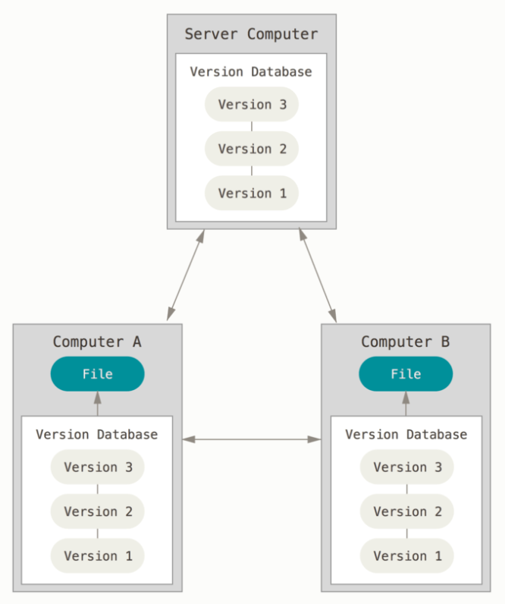
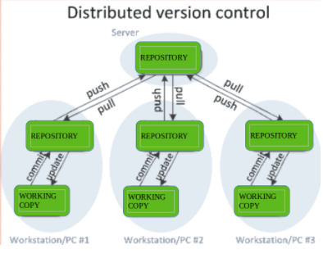
1.4. Types of VCSs (3)
Distributed Version Control Systems
In a DVC system, clients don’t just check out the latest snapshot of the files; rather, they fully mirror the repository, including its full history. Thus, if any server dies, and these systems were collaborating via that server, any of the client repositories can be copied back up to the server to restore it. Every clone is really a full backup of all the data.
Just committing your changes will not give others access to your changes. This is because commit will reflect those changes in your local repository and you need to push them in order to make them visible on the central repository. Similarly, when you update, you do not get other’s changes unless you have first pulled those changes into your repository.

Slide 10
2. Git

Slide 11
2.1. What is Git?
Git is the most popular Distributed Version Control System. It was created in 2005 by Linus Torvalds for development on the Linux kernel. The main strong points of git are its speed and its great support for non-linear workflows (branching).
Git is free and open-source with the latest version being 2.29.2 - released 29.10.2020.

Slide 12
2.2. Basic concepts
Repository
Workspace
Snapshots
Commits
Branching

Slide 13
Repository
A git repository represents the .git directory in the project’s folder. This folder contains all the information that git needs to manage the project, like all the changes made to each file over time, commit objects, remote repositories information etc. In order to save space, git compresses all the information it can.
There are two types of repositories:
Local repository: the local .git folder
Upstream repository: version of the project hosted on the network

Slide 14
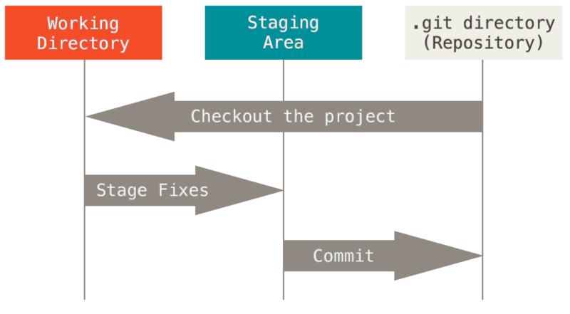
Workspace
The git workspace represents the local checkout of the project. Git has three main states that your files can reside in:
Modified - modified, but not committed to the database yet
staged - modified file marked as to be part of the next commit
committed - saved securely in the git database

Slide 15
Snapshots
Most VCSs create the history of a file by combining the base file and deltas with each modification. When changes add up, executing certain commands will become very slow.
Git stores changes as snapshots. A snapshot is a miniature of the filesystem containing all the modified files as they are and links to the unchanged files.

Slide 16
Commits
Commits are the core building block units of a Git project timeline. Commits are milestones along the timeline of a Git project.
A git commit consists of: a pointer to a snapshot, information about the author and the date of creation, description and pointers to one or multiple previous commits (in case of merges) in the git history.
In order to be a part of the commit, files have to be staged first.
Commits are only created in the local repository and are usually pushed to the upstream repository afterwards.

Slide 17
Branching
Branching means diverging from the main line of development and continuing to do work without messing with that main line.
A branch represents a movable pointer to a git commit.
HEAD: a pointer to the top of a branch
As opposed to usual VCSs, working with branches in git is nearly instantaneous.

Slide 18
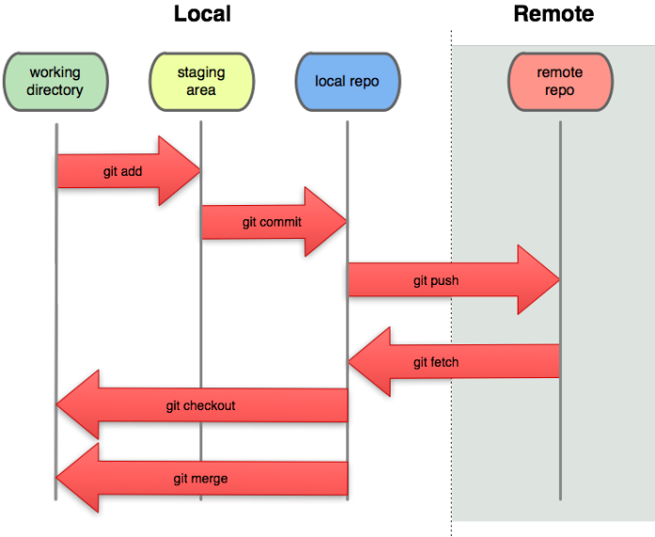

Slide 19
3. Bitbucket

Slide 20
3.1. What is Bitbucket?
Bitbucket Cloud is Atlassian's web-based git repository hosting service. In addition to repository management, it provides many other features like pull requests with code review and comments, continuous delivery pipelines, etc.

Slide 21
4. Working with Git on a local repository

Slide 22
Git init
The git init command creates a new Git repository. It can also be used to create a Git repository in an existing, unversioned project.
Executing git init creates a .git subdirectory in the current working directory, which contains all of the necessary Git metadata for the new repository. It will also create a new master branch.

Slide 23
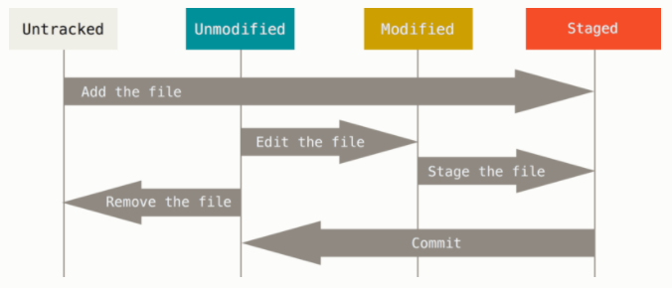
Saving changes
A commit is the Git equivalent of saving a snapshot of a Git project's current state.
Each file in the working directory can be in one of the following states:
untracked: The file is new, Git knows nothing about it. If you git add <file>, it becomes:
staged: Now Git knows the file (tracked), but also made it part of the next commit batch (called the index). If you git commit, it becomes:
unmodified: The file has not changed since its last commit. If you modify it, it becomes:
modified/unstaged: Modified but not part of the next commit yet. You can stage it again with git add

Slide 24
Git status
The git status command displays the state of the working directory and the staging area. It lets you see which changes have been staged, which haven’t, and which files aren’t being tracked by Git.

Slide 25
Git add
The git add command adds a change in the working directory to the staging area (index). It tells Git that you want to include updates to a particular file in the next commit. However, git add doesn't really affect the repository in any significant way — changes are not actually recorded until you run git commit.
git add is used for both tracking untracked files and staging modified file.
You can untrack an uncommitted file with git rm --cached <file> and unstage a staged file with git reset HEAD <file>
Examples:
Add a single file to index:
$ git add src/ro/ubbcluj/cs/Calculator.java
Add untracked and modified files from the current directory to index:
$ git add .

Slide 26
Git commit
The git commit command captures a snapshot of the project's currently staged changes. Committed snapshots can be thought of as “safe” versions of a project — Git will never change them unless you explicitly ask it to. Each commit contains a log message describing the changes, including information about the author and time of creation.
Note that commits will reflect changes in your local repository and you need to git push them in order to make them visible on the central repository.
Examples:
Create a commit with the given message:
$ git commit -m “awesome feature”
Modify latest commit:
$ git commit -m “awesome feature” --amend

Slide 27
Git log
The git log command shows commit logs. The advanced features of git log can be split into two categories: formatting how each commit is displayed, and filtering which commits are included in the output.
Examples:
View all commits on the current branch in reversed chronological order:
$ git log
View commits on the current branch filtered by author:
$ git log --author="johndoe"

Slide 28
Git diff
Diffing is a function that takes two input data sets and outputs the changes between them. git diff is a multi-use Git command that when executed runs a diff function on Git data sources. These data sources can be commits, branches, files and more.
Examples:
View changes on the current unstaged files:
$ git diff
View unstaged changes on a specific file:
$ git diff src/ro/ubbcluj/cs/Calculator.java
Compare two different commits:
$ git diff 9ebe78ecfa14049aa800bc24bd96e752304bc7e7 6ad9d4c190e9ab8126c834c8fa7a11f2e299f09b
Compare two different branches:
$ git diff master some-feature

Slide 29
Git stash
The git stash command takes your uncommitted changes (both staged and unstaged), saves them away for later use, and then reverts them from your working copy.
Stashing is handy if you need to quickly switch context and work on something else, but you're mid-way through a code change and aren't quite ready to commit. You can then come back and re-apply the stashed changes later on.
Examples:
Stash current uncommitted changes:
$ git stash
Restore changes from stash:
$ git stash pop

Slide 30
.gitignore
A .gitignore file specifies intentionally untracked files that Git should ignore. Files already tracked by Git are not affected.
Ignored files are usually build artifacts and machine generated files that can be derived from your repository source or should otherwise not be committed. Some common examples are:
dependency caches, such as the contents of /node_modules or /packages
compiled code, such as .o, .pyc, and .class files
build output directories, such as /bin, /out, or /target
files generated at runtime, such as .log, .lock, or .tmp
hidden system files, such as .DS_Store or Thumbs.db
personal IDE config files, such as .idea/workspace.xml

Slide 31
Using branches
Git branches are effectively a pointer to a snapshot of your changes, an independent line of development.
Branching means you diverge from the main line of development and continue to do work without messing with that main line.
You can think of them as a way to request a brand new working directory, staging area, and project history. New commits are recorded in the history for the current branch, which results in a fork in the history of the project.
When initialising a git repository, a new master branch will be created by default.
Way of working:
When you want to add a new feature or fix a bug you spawn a new branch to encapsulate your changes.
By developing features on different branches, it’s not only possible to work on both of them in parallel, but it also keeps the main master branch free from unstable code.

Slide 32
Git branch
The git branch command lets you create, list, rename, and delete branches.
Examples:
List local branches:
$ git branch
Create a new branch:
$ git branch some-feature
Delete “some-feature” branch:
$ git branch -d some-feature

Slide 33
Git checkout
In Git terms, a "checkout" is the act of switching between different versions of a target entity. The git checkout command operates upon three distinct entities: files, commits, and branches.
Our focus will be checkout operations on branches. The git checkout command lets you switch between the branches created by git branch.
Examples:
Switch to “some-feature” branch:
$ git checkout some-feature
Create and switch to “some-feature” branch:
$ git checkout -b some-feature

Slide 34
Git merge (1)
Merging is Git's way of putting a forked history back together again. The git merge command lets you take the independent lines of development created by git branch and integrate them into a single branch.
The current branch will be updated to reflect the merge, but the target branch will be completely unaffected.
Examples:
Merge “some-feature” branch into “master”:
$ git checkout master; git merge some-feature

Slide 35
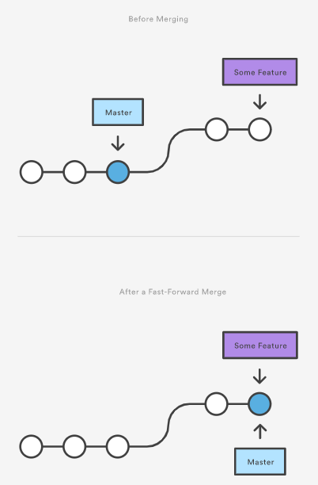
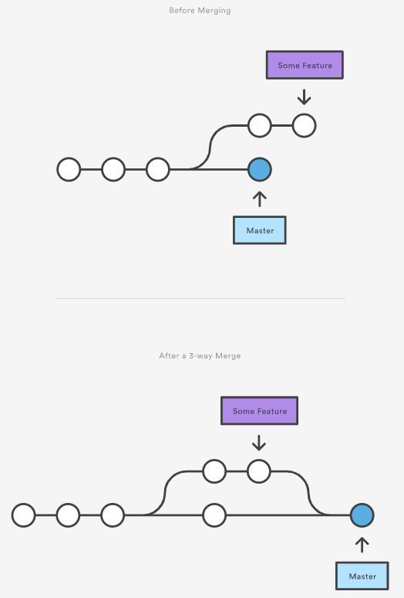
Git merge (2)
There are two main ways Git will merge:
Fast Forward
occurs when there is a linear path from the current branch tip to the target branch
Three way
occurs when the branches have diverged, so fast-forward merge is not possible.
3-way merges use a dedicated commit to tie together the two histories. The nomenclature comes from the fact that Git uses three commits to generate the merge commit: the two branch tips and their common ancestor.

Slide 36
Solving merge conflicts
If the two branches you're trying to merge both changed the same part of the same file, Git won't be able to automatically combine them. This scenario is a version control conflict and Git will need the user to resolve the conflicts manually.
When Git encounters a conflict during a merge, it will edit the content of the affected files with visual indicators that mark both sides of the conflicted content. These visual markers are: <<<<<<<, =======, and >>>>>>>. It’s helpful to search a project for these indicators during a merge to find where conflicts need to be resolved. Generally the content before the ======= marker is the receiving branch and the part after is the merging branch.
Once you manually resolve the conflicts, you have to run git add on the conflicted file(s) to tell Git they're resolved. Then, you run a normal git commit to generate the merge commit.
Note that merge conflicts will only occur in the event of a 3-way merge. It’s not possible to have conflicting changes in a fast-forward merge.

Slide 37
Git reset
The git reset command is a complex and versatile tool for undoing changes. It has three primary forms of invocation. These forms correspond to command line arguments --soft, --mixed, --hard. The three arguments each correspond to Git's three internal state management mechanisms, The Commit Tree (HEAD), The Staging Index, and The Working Directory.
Examples:
Move current branch backwards by 1 commit:
$ git reset --hard HEAD~1
Reset the commit history to match the “master” branch, leaving the staged and unstaged files untouched:
$ git reset --soft master
Reset the commit history, staged and unstaged files to match the given commit hash:
$ git reset --hard 774f9eeeff9a25b8285327bffc82cd870ca7aea2

Slide 38
Git cherry-pick
The git cherry-pick command enables arbitrary Git commits to be picked by reference and appended to the current working HEAD. Cherry picking is the act of picking a commit from a branch and applying it to another.
Examples:
Add a commit from a different branch to the current branch:
$ git cherry-pick 64db6231943e9e650e8ee93b0841db8f8b2b4629

Slide 39
5. Working with Git on a remote repository

Slide 40
5.1. Creating a remote repository
Remote repositories are versions of your project that are hosted on the Internet or network somewhere. Collaborating with others involves managing these remote repositories and pushing and pulling data to and from them when you need to share work.
Visit https://bitbucket.org/ and create an account
Create Repository

Slide 41
Adding a remote repository to the local repository
The git remote command lets you create, view, and delete connections to other repositories. Remote connections are more like bookmarks rather than direct links into other repositories. Instead of providing real-time access to another repository, they serve as convenient names that can be used to reference a not-so-convenient URL.
Examples:
Add a remote repository to the current local repository:
$ git remote add origin https://roxylascu@bitbucket.org/roxylascu/gitdemo.git
List the remote connections to other repositories:
$ git remote -v

Slide 42
5.2. Cloning an existing remote repository
If a project has already been set up in a central repository, the git clone command is the way for users to obtain a copy of the existing Git repository. The “working copy” is a full-fledged Git repository—it has its own history, manages its own files, and is a completely isolated environment from the original repository. Every version of every file for the history of the project is pulled down by default when you run git clone. In fact, if your server disk gets corrupted, you can often use nearly any of the clones on any client to set the server back to the state it was in when it was cloned.
Like git init, cloning is generally a one-time operation. Once a developer has obtained a working copy, all version control operations and collaborations are managed through their local repository.
Cloning automatically creates a remote connection called "origin" pointing back to the original repository, creates remote-tracking branches for each branch in the cloned repository, and creates and checks out an initial branch that is forked from the cloned repository’s currently active branch.
Examples:
$ git clone https://roxylascu@bitbucket.org/roxylascu/gitdemo.git

Slide 43
Git fetch
The git fetch command downloads commits, files, and refs from a remote repository into your local repository. Fetching is what you do when you want to see what everybody else has been working on. Git will download the remote content but not update your local repository's working state.
Examples:
Fetch the “master” branch from the remote repository:
$ git fetch origin master
Fetch all branches from the remote repository:
$ git fetch --all

Slide 44
Git pull
The git pull command is used to download content from a remote repository and immediately update the local repository to match that content. The git pull command is actually a combination of git fetch followed by git merge.
Examples:
Download and merge the “master” branch from the remote repository into the current local branch:
$ git pull origin master
If the current local branch is tracking the remote “master” branch you can simply use:
$ git pull

Slide 45
Git push
The git push command is used to upload local repository content to a remote repository. Pushing is how you transfer commits from a local branch to a remote branch.
Examples:
Push the some-feature branch to the remote repository
$ git push origin some-feature
Set up local branch “some-feature” to track remote branch “some-feature” from “origin”
$ git branch --set-upstream-to=origin/some-feature some-feature
Push the some-feature branch to the remote repository, and track it
$ git push -u origin some-feature

Slide 46
Bibliography
https://git-scm.com/book/en/v2
https://www.atlassian.com/git/tutorials
https://git-scm.com/docs
https://stackoverflow.com

Slide 47
Q&A

